Slide 1
Building the Y86 Simulator
09300240004 朱恬骅

Slide 2
Structure Overview
Simulator
Memory Block
Register File
F/D/E/M/W Stages
Processor
Clock
UI
Watch Windows
Settings
Misc.
Assemble
Disassemble

Slide 3
Stages
Base class: Stage
Provides general properties including ICode, Bubble and Stall, and a method Update
Fetch Stage
Decode Stage
Execute Stage
Memory Stage
Each child class implements the function, with their signals and registers publicized

Slide 4
Clock as an Event
To simulate clock edge, the Clock class raises an OnClick event in every interval (typically 100 milliseconds).
By subscribing to this event, the Processor updates the status of every stage component.

Slide 5
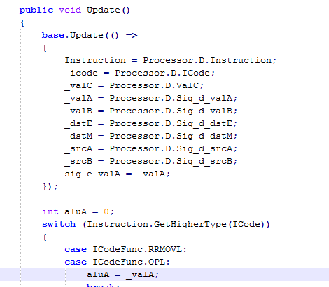
The Update method of Stage class
Implements “Bubble” and “Stall,” which forbids illegal updating registers while bubbling or stalling.
Use of Lambda Expression has simplified inter-thread calls.

Slide 6
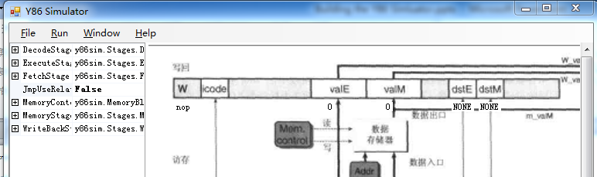
The UI
The main frame shows the structure of a Y86 processor.
By using PropertyView control, the interface is concise and coding for UI is also simplified.

Slide 7
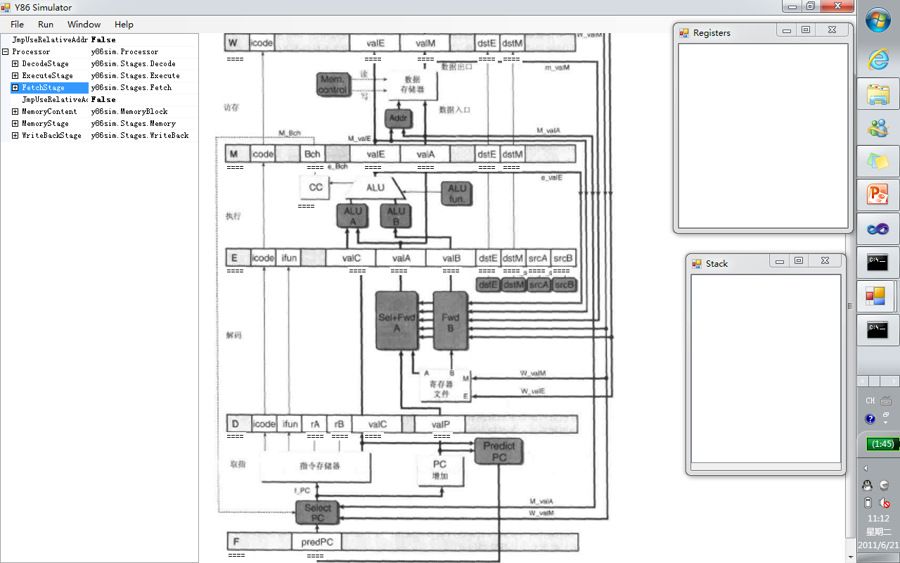
The UI

Slide 8
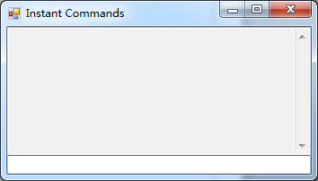
The Instant Commands Window
A failed experiment
Intends to insert manually a instruction during step execution, just before the currently-fetching instruction
Results in overwriting

Slide 9
… and other Wastes
An instruction cache [InstructionList, Instruction] – not used
I don’t think it is a good idea to build a “very large” instruction cache, with every instruction preliminarily analyzed and stored, for this is not real in Y86 processor.
A TreeView version of the UI
PropertyView is enough.

Slide 10
Feelings and Conclusion
This lab enables/forces me to go over/understand better Chapter 4
A better UI control, a better command/choice of the programming language may simplify most of repeated and less-valued work.
A clear in-advance framework design is necessary.

Slide 11
Acknowledge -ments
With acknowledgements to 杨恺希、陈巍峰、陈鑫涛、沈诗旸 etc. for their suggestions

Slide 12
Thank You!
09300240004 朱恬骅

